Slide 1
Machine Learning PROJECT
The Gradient Grinders
Project 5: Identify Hard stop and momentary stop using vehicle trajectory dataset.
GROUP MEMBERS:
Kathan Thakkar AU2140040
Yax Prajapati AU2140230
Harsh Pandya AU2140171
Dhruvi Rajput AU2140224
Instructed by Professor Mehul Raval

Slide 2
Description
We have extracted trajectories of vehicles across the signalized intersection. At intersections, we assume drivers are following signals and hence at the RED signal, vehicles stop and again start. This will make a momentary STOP situation. Whereas in the same video, there are some parked vehicles which are in stop condition throughout which create a Hard stop condition. We identified the time instance and locality in both the cases. We use velocity as a parameter and did spatio-temporal analysis. A binary classifier is required to classify the “Hard” and “Momentary” stop conditions.

Slide 3
Literature Survey
Author | Published Year | Publication Title | Key Findings
Fanaee, H. (n.d.) | 2012 | Spatio-Temporal Clustering Methods Classification. | Spatial Clustering, Spatial Temporal Clustering, Data Mining, GIS.
Wu, T. (n.d.) | 2021 | Extracting Stops from Spatio-Temporal Trajectories within Dynamic Contextual Features. | Trajectory Data, Data Mining, Stop Identification, SVM.
Paper1: https://www.researchgate.net/publication/236002026_Spatio-Temporal_Clustering_Methods_Classification
Paper2: https://www.mdpi.com/2071-1050/13/2/690

Slide 4
Assumptions
if row['Vxy_smoothed'] < 1 and -1 <= row['acceleration'] <= 1:
return 'possible_hard'
elif 0 <= row['Vxy_smoothed'] <= 5 and row['acceleration'] < 0:
return 'possible_soft'
else:
return 'other'

Slide 5
Datasets Discussion
Track id
X-coordinate
Y-coordinate
Velocity
Acceleration
Label

Slide 6
Approach
Derived acceleration and provided labels to the each rows using data processing and presumptions.
Found the optimal values of epsilon and min_data_points using grid search.
Made clustering for X,Y coordinates for labels.
Plotted the data using matplot library on the frame.
Checked for vehicles whose label is not equal to the above classified label and lies in the cluster coordinate ranges.
Found average velocity of the vehicles.
checked if velocity lies in the range of presumption range.
From that, clusters with avg velocity lying as per the presumptions is declared as hard stop or soft stop.

Slide 7
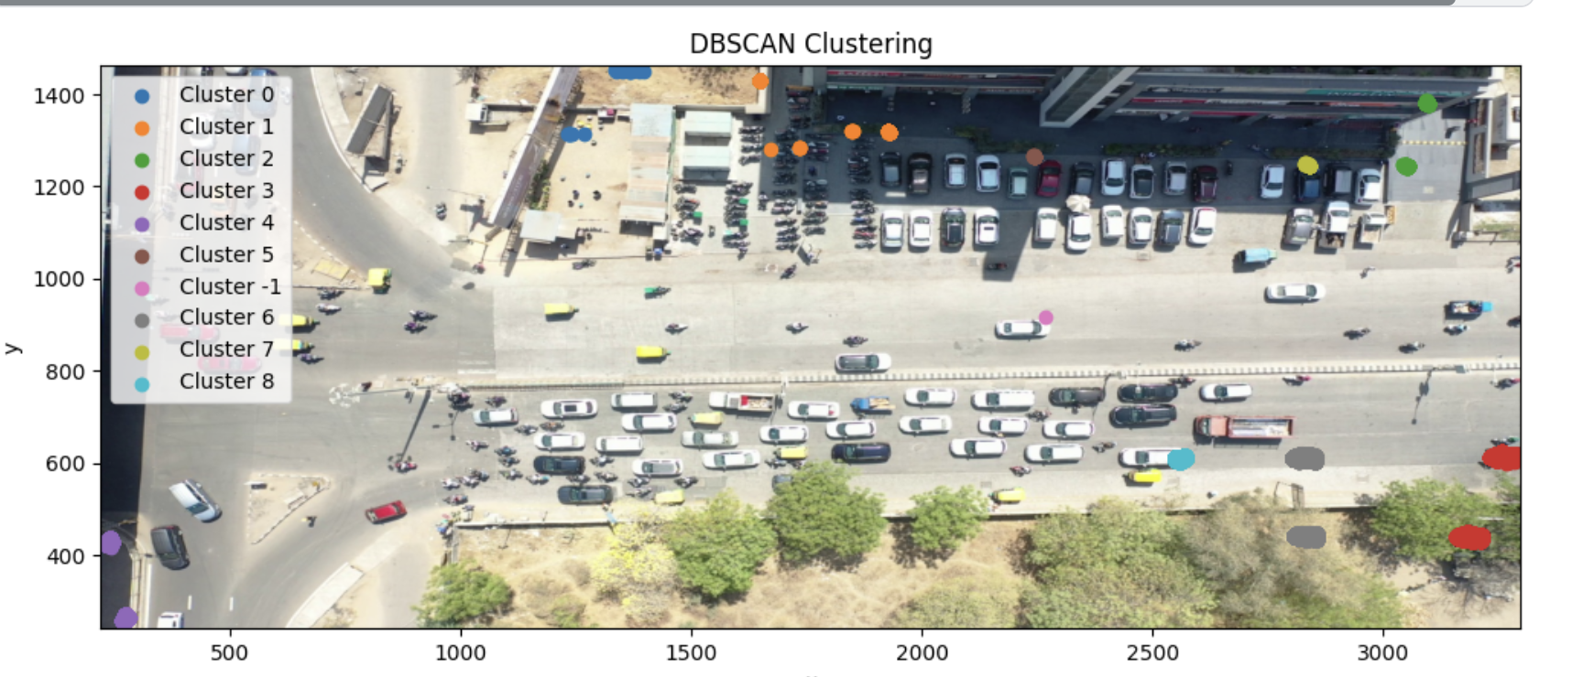
Results
Hard Stop

Slide 8
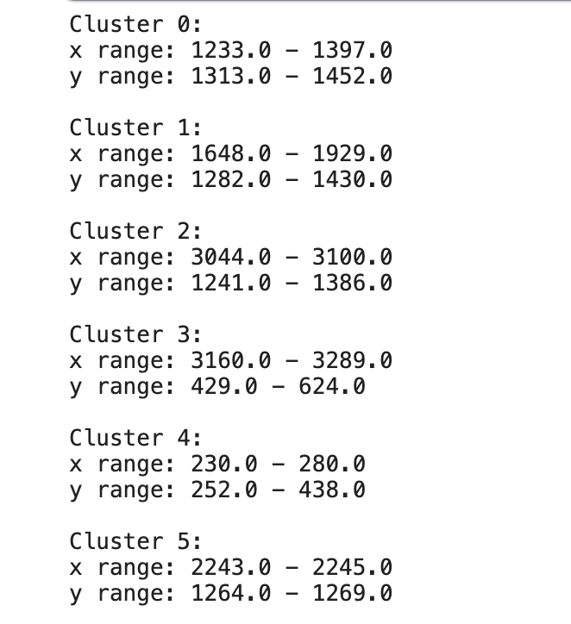
Results: Range of coordinates for hard stop

Slide 9
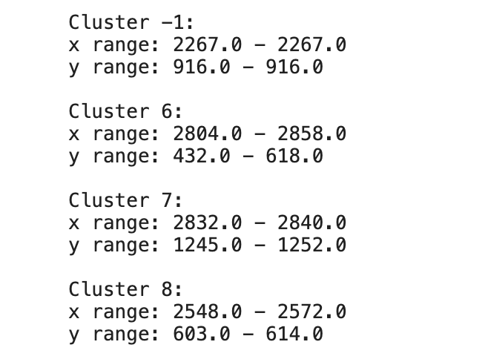
Results: Range of coordinates for hard stop

Slide 10
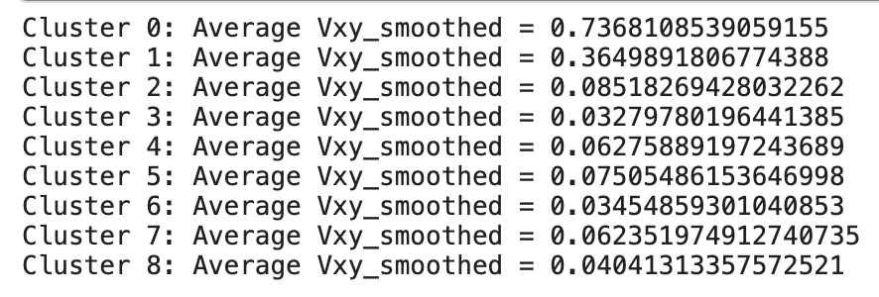
Avg velocity around hard stop clusters

Slide 11
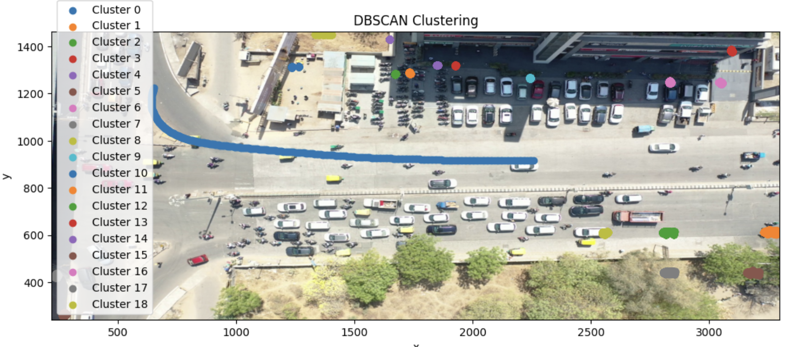
Results
Soft Stops

Slide 12
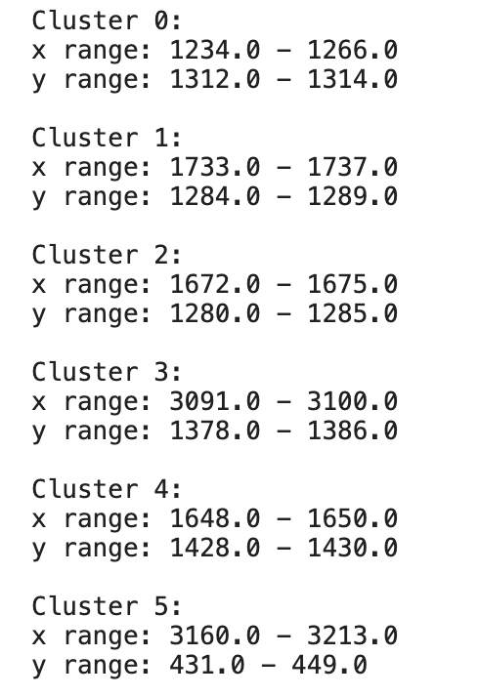
Results: Range of coordinates for soft
stop

Slide 13
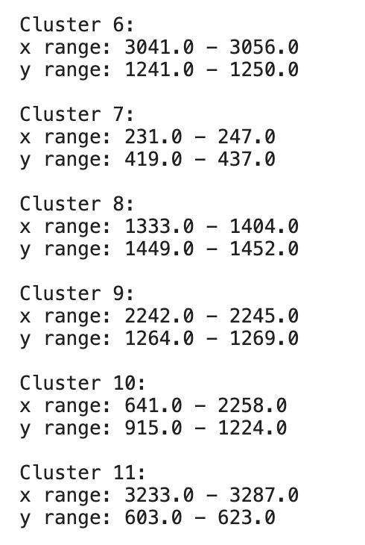
Results: Range of coordinates for soft
stop

Slide 14
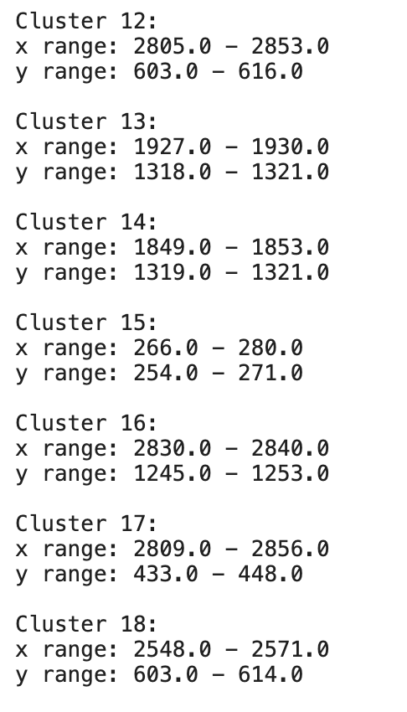
Results: Range of coordinates for soft
stop

Slide 15
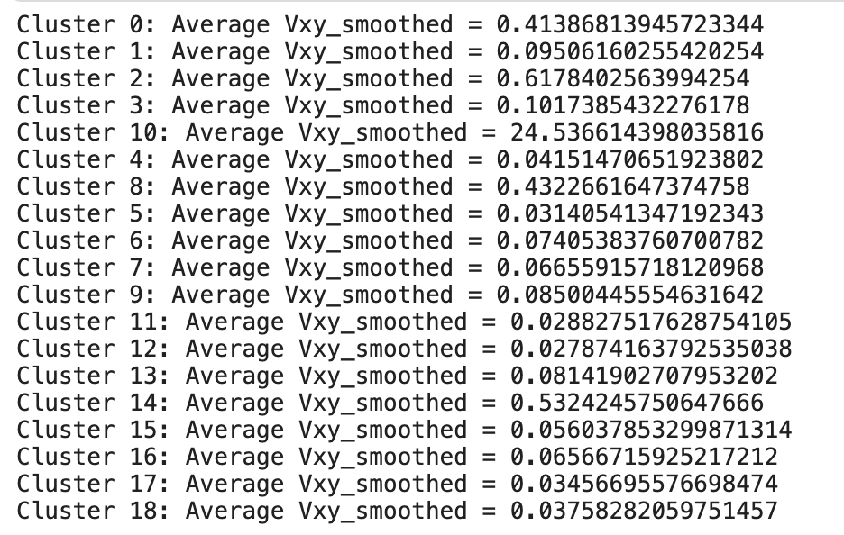
Avg velocity around soft stop clusters

Slide 16
Code Link:
https://www.kaggle.com/code/yaxprajapati/notebook7562088143/edit

Slide 17
THANK YOU!

